Slide 1
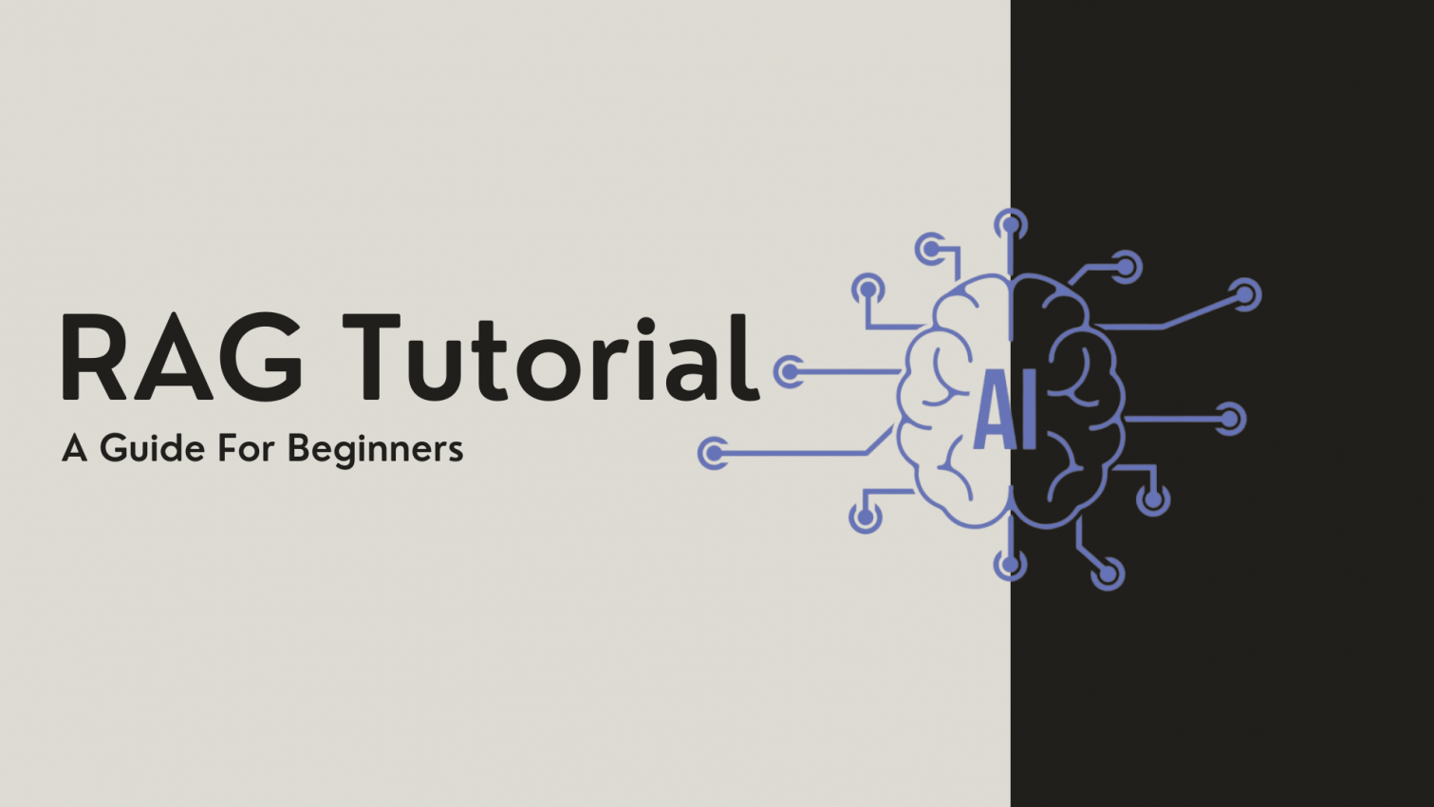

Slide 2
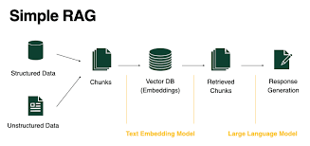
Vector Databases & RAG
vector databases and retrieval-augmented generation, transforming how we access and utilize information.

Slide 3
Agenda
What is a Vector Database?
How Retrieval-Augmented Generation (RAG) Works
Real-World Analogies
Simple RAG Demo (with Code)
Demo Using FAISS or ChromaDB
Summary and Q&A

Slide 4
What is a Vector?
A numeric representation of text (sentence, document).
01
Vector Databases
They use similarity metrics for efficient data retrieval in high-dimensional space.
02
It is a specialized database designed to store and query vector embeddings. Embeddings are high-dimensional numerical representations of data, typically generated by AI models They capture semantic meaning, enabling tasks like:
03

Slide 5
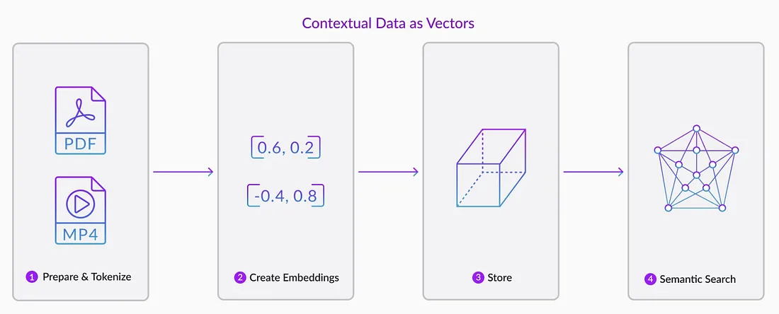

Slide 6
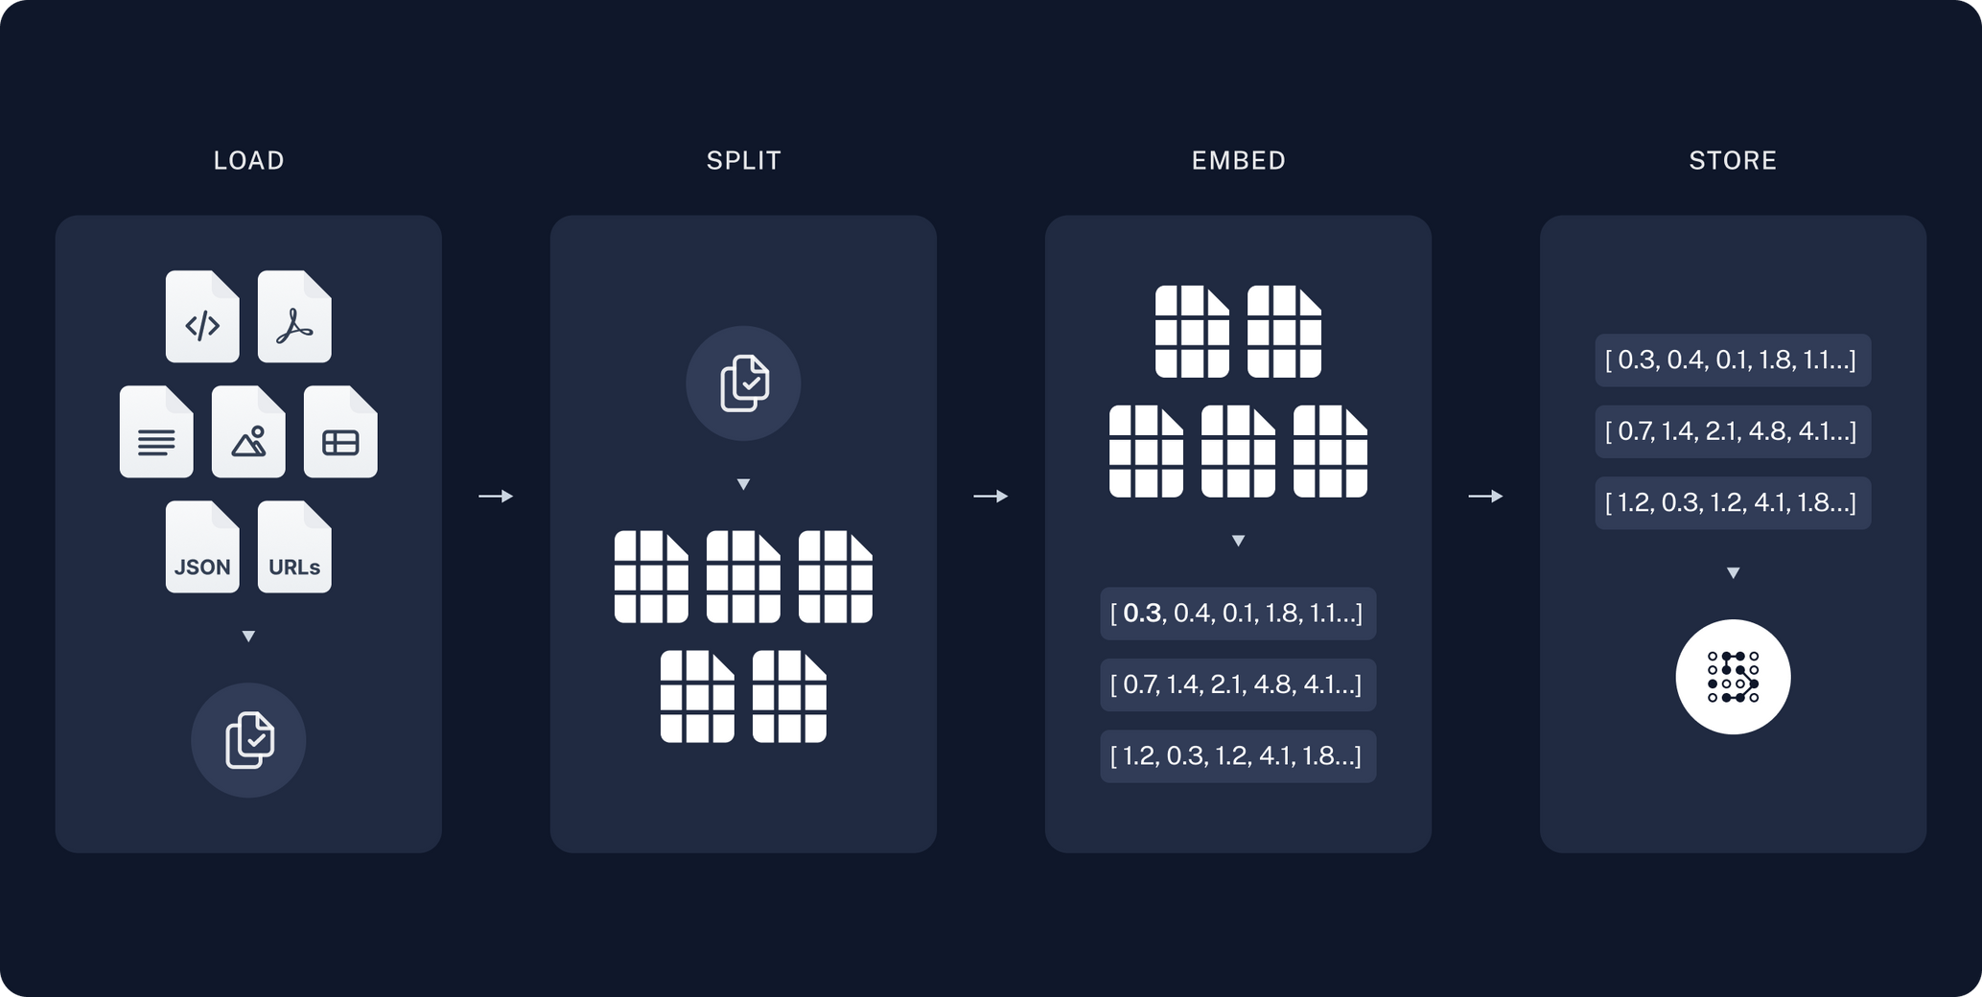

Slide 7
They capture semantic meaning, enabling tasks like:
Semantic Search: Retrieve documents based on meaning rather than exact keyword matches.
Question Answering: Find contextually relevant information for answering user queries.
Personalized Recommendations: Match users with content based on preferences encoded in vector embeddings.

Slide 8
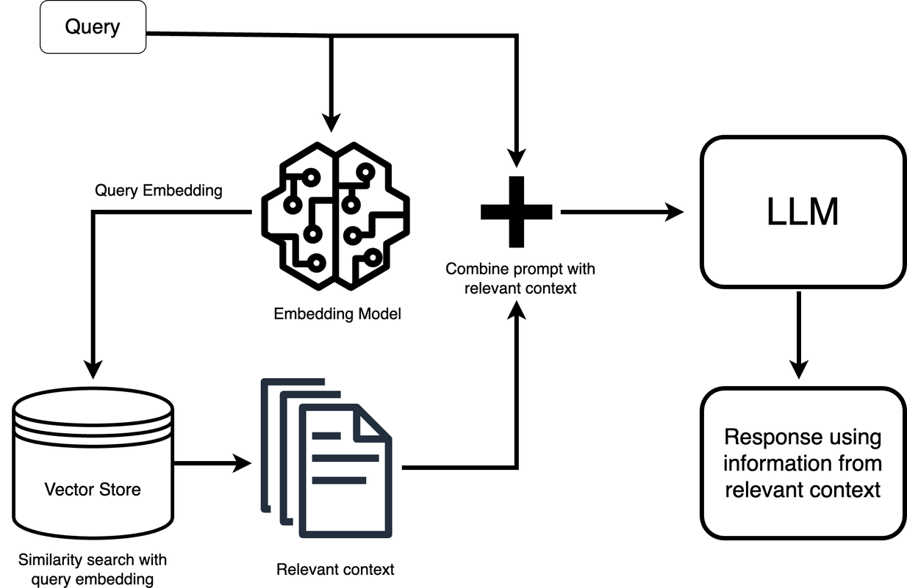
Understanding the RAG Process

Slide 9
What is RAG?
The full form of RAG is Retrieval Augmented Generation.
Retrieval Augmented Generation is a framework or a pipeline that allows your LLM to connect with current/real-world domain-specific data.
It is a combination of three English words: Retrieval, Augmented, and Generation.
Retrieval is about extracting relevant information.
Augmented refers to using the relevant retrieved information with the input or from the input to the Large Language Model (LLM).
Generation is the process of generating an output based on given inputs. In the context of LLMs, this means generating text based on an input prompt.
The goal of RAG is simple: take information, pass it to an LLM, and based on that, generate output.

Slide 10
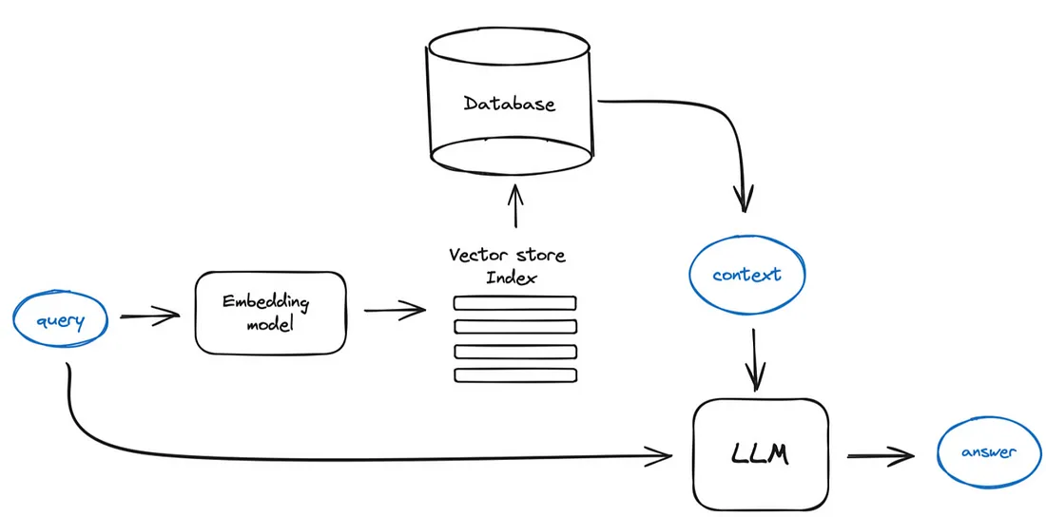
RAG Architecture

Slide 11
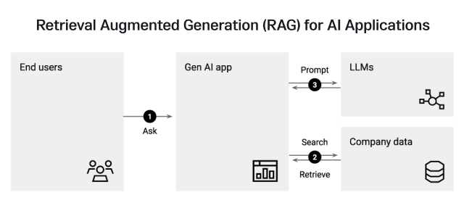

Slide 12
Demo Code Overview
Key steps to implement Vector Databases and RAG effectively
The code implementation involves initializing a vector database, followed by retrieving relevant data based on user queries, and finally processing those inputs through the LLM to generate insightful answers.

Slide 13
Vector databases enable efficient storage and retrieval of high-dimensional data.
01
Key Takeaways
RAG combines retrieval with language models to enhance answer generation.
02
Understanding Vector Databases and RAG is crucial for modern applications.
03
This approach improves accuracy and relevance in various applications.

Slide 14
Using RAG is to improve the generation process
RAG helps to improve output generation by reducing hallucinations. Hallucination is a common problem in LLMs where they may generate something that looks correct but might be factually incorrect or misleading.
RAG is particularly useful for working with custom data.

Slide 15
Advance tech use with RAG
LLM MODELS
CHATBOT
LANGCHAIN
LANGCHAIN
These tools we use to create production level project

Slide 16
Summary
"Today we learned that vector databases help find meaning, and RAG combines retrieval with generation to answer questions accurately."
"You can build simple RAG systems quickly with tools like FAISS or Chroma and powerful LLMs."
"Thank you! Feel free to ask questions or check out my code/demo linked below."

Slide 17
Thank you!

